Slide 1



Tourism Challenge by Codebasics

Slide 2
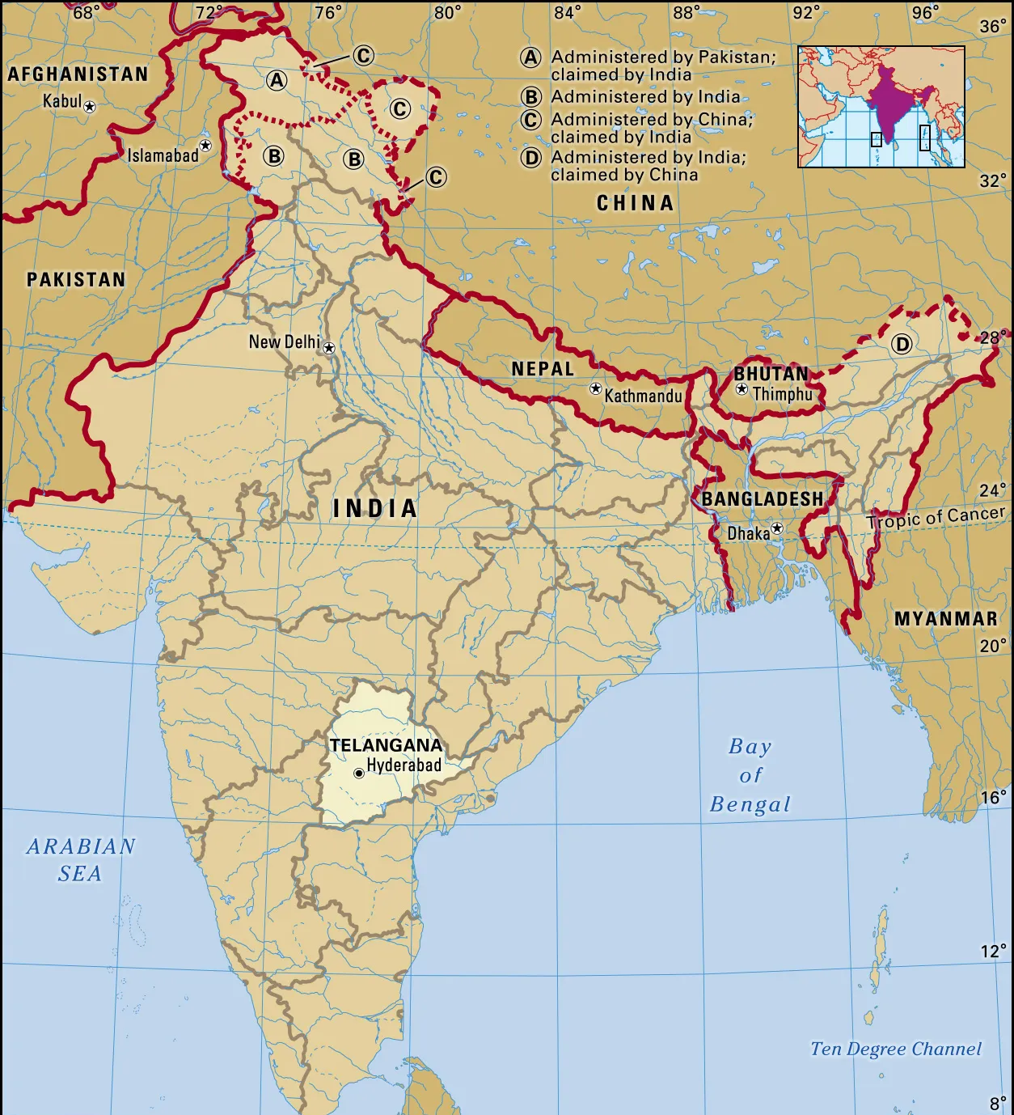

About Telangana
Telangana, constituent state of south-central India. It is bordered by the states of Maharashtra to the north, Chhattisgarh and Odisha to the northeast, Andhra Pradesh to the southeast and south, and Karnataka to the west.

